Slide 1
bookly
final presentation

Slide 2

Outline
Use Cases
Project Management
Architecture
Quality
Demo

Slide 3
Use-Cases

Slide 4
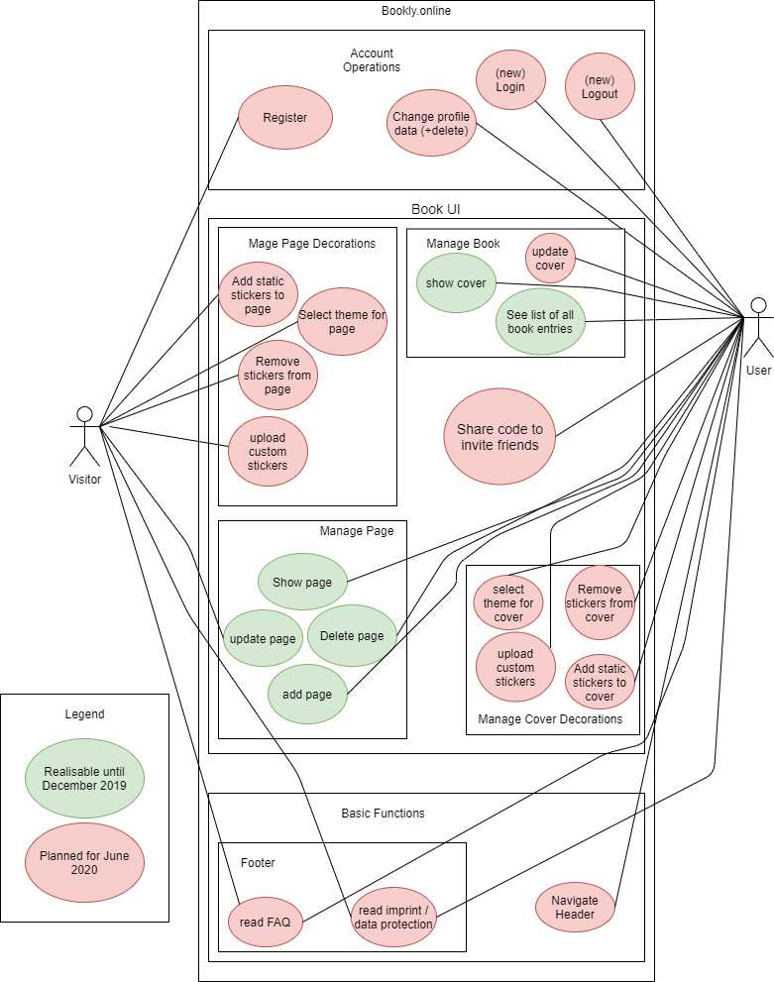
Extend of functionality

Slide 5
Extend of functionality

Slide 6
Use CaseS for Mockup
CRUD: Manage page
C: create page entry
R: read an entry
U: update/edit an entry
D: delete an entry
CRUD: Manage book
C: create a book
R: show cover/title
U: update cover/title
D: delete (with account)

Slide 7
Use CaseS for Mockup
CRUD: Manage Page Decorations
C: create sticker
R: read sticker
U: update sticker
D: delete sticker
Navigate Header
Navigate Footer
Share Code
Navigate Account
CRUD: Manage Cover Decorations
C: create sticker
R: read sticker/theme
U: update sticker/theme
D: delete sticker

Slide 8
Cost Estimation
TODO:
Cost Estimation (FP -> time (time is money)) / comparison of estimation vs. real time spent.

Slide 9
Project Management

Slide 10
RUP- Rational Unified Process
Alexandra
Requirements Specifier: Describe and phrase the features / design of the website with the team
Project Manager: Phrase acceptance criteria of the features + Coordinate sprints + Manage YouTrack + Assign Tags
Jeanne
Implementer: Create database structure, logic, and interfaces (API)
Tester: Test the interfaces (APIs) between Frontend, Backend, Database and the functionality of the Frontend
Nico
Deployer: Host domain and integrate CI (and Docker)
Designer: Implement the design described in the Use-Cases + Web tests

Slide 11
RUP- Workflow

Slide 12
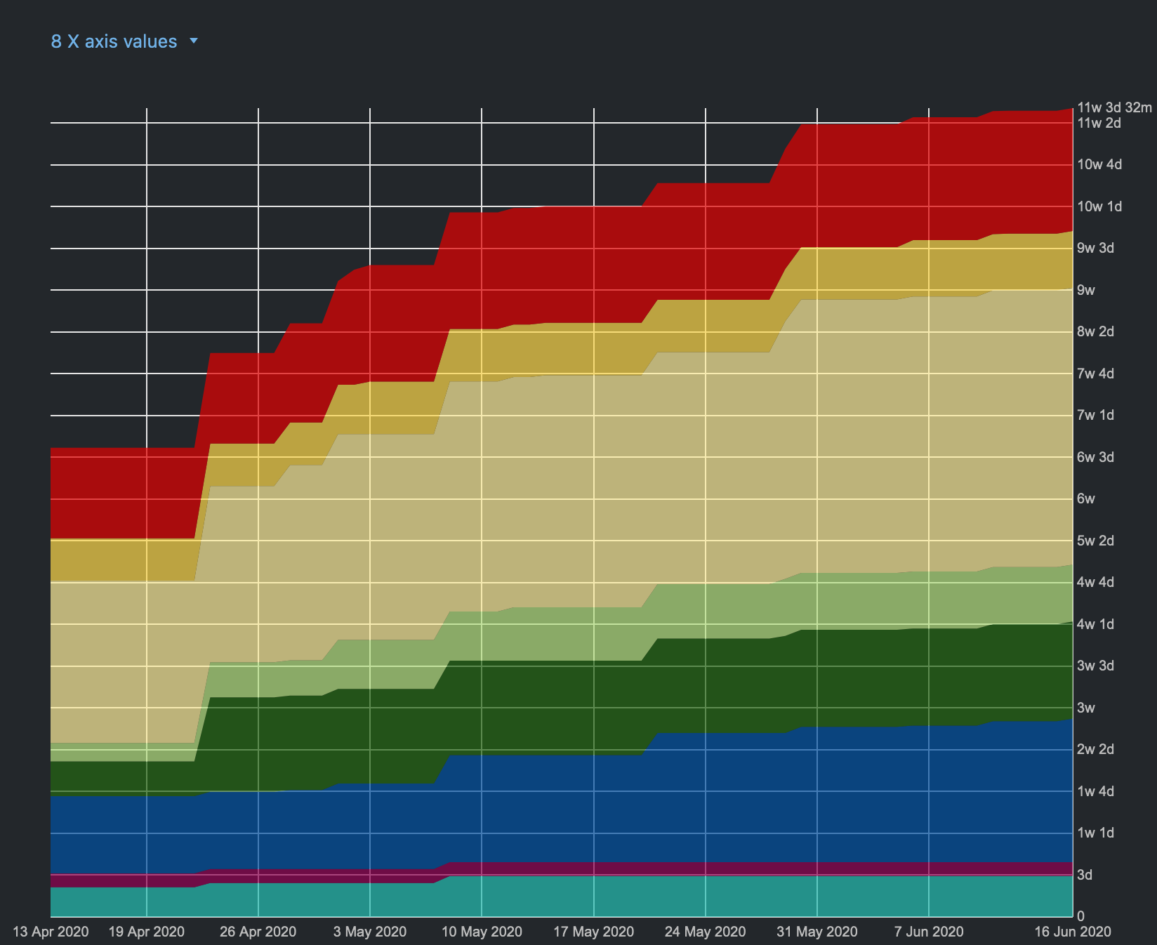
RUP- Workflow - 2020

Slide 13
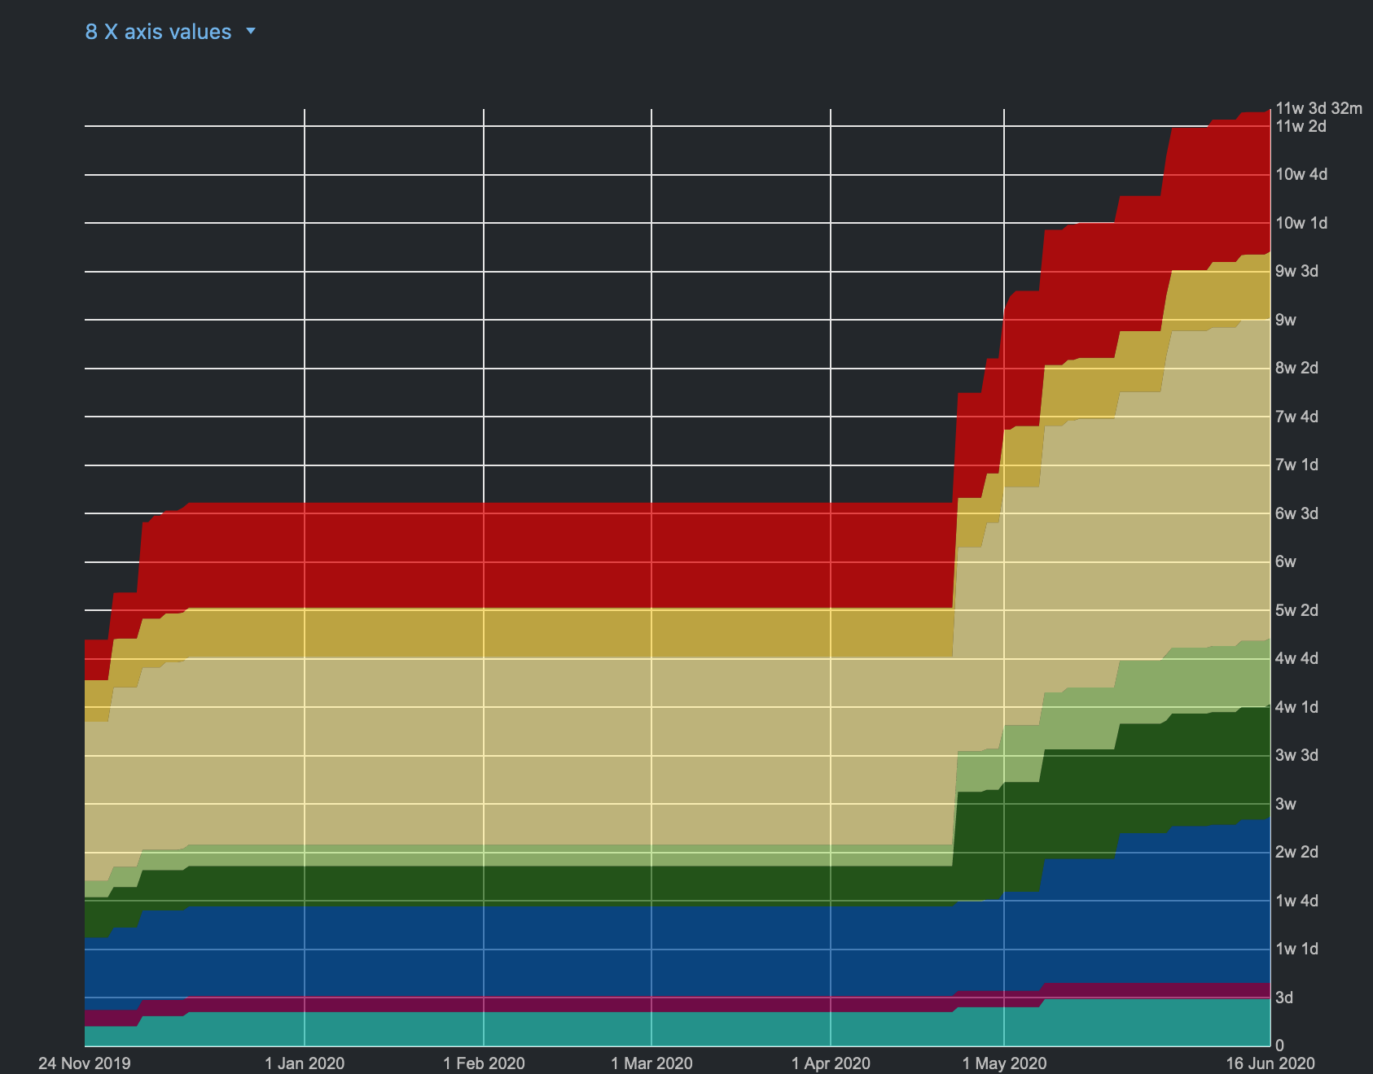
RUP- Workflow - complete

Slide 14
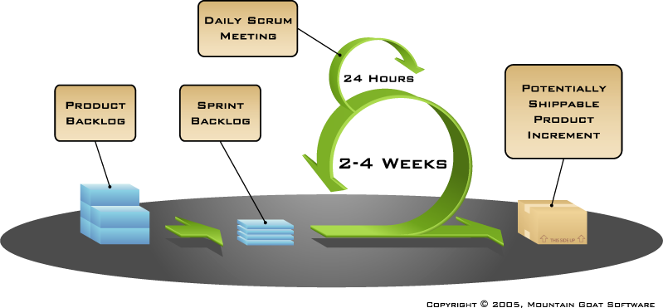
Scrum and Youtrack
weekly

Slide 15
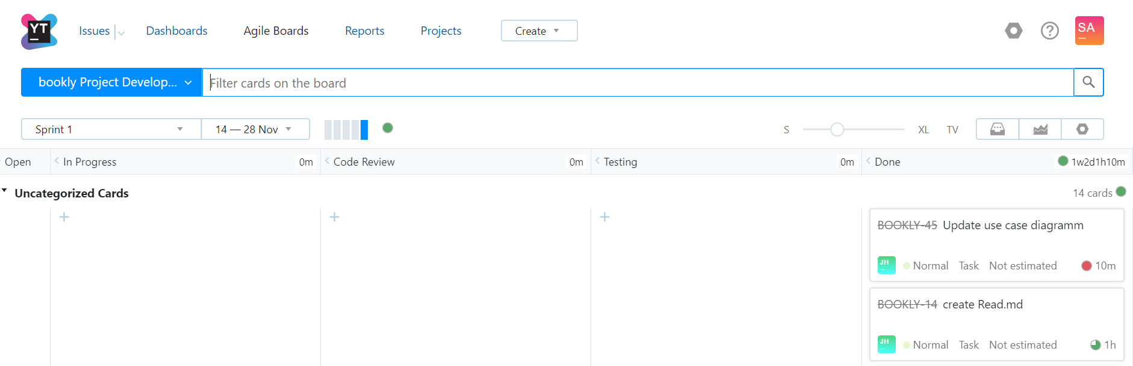
Scrum and Youtrack

Slide 16
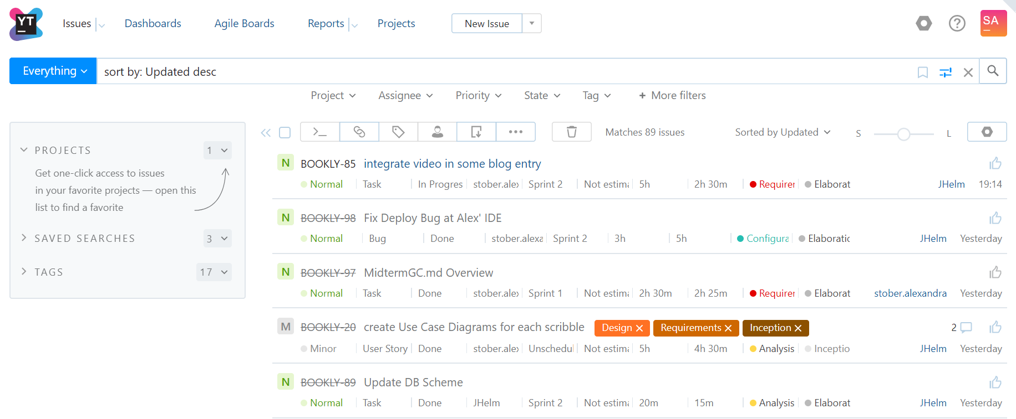
Scrum and Youtrack

Slide 17
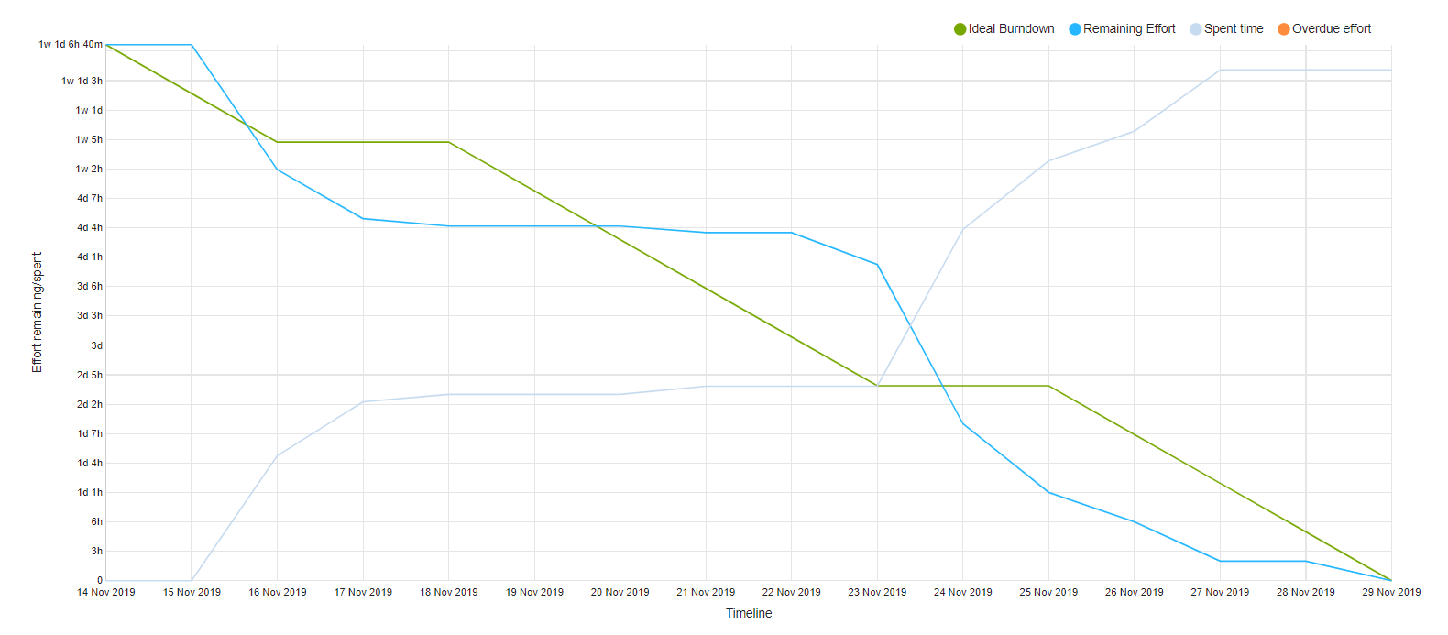
Burn-Down-Chart
► more

Slide 18
Risk Management
Risk Mgmt.- (excel sheet that shows that you have a list of risks that you kept up to date on a weekly basis, how you mitigated risks - dont show an xcel sheet during a presentation!)
-> BUT DO NOT SCROLL THROUGH AN EXCEL IN THE PRESENTATION!

Slide 19
Architecture

Slide 20

Main Idea

Slide 21
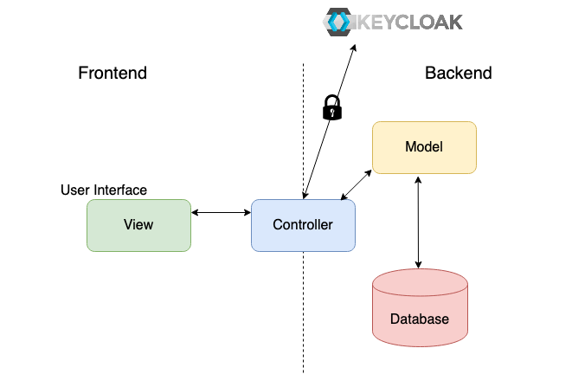
Overview

Slide 22
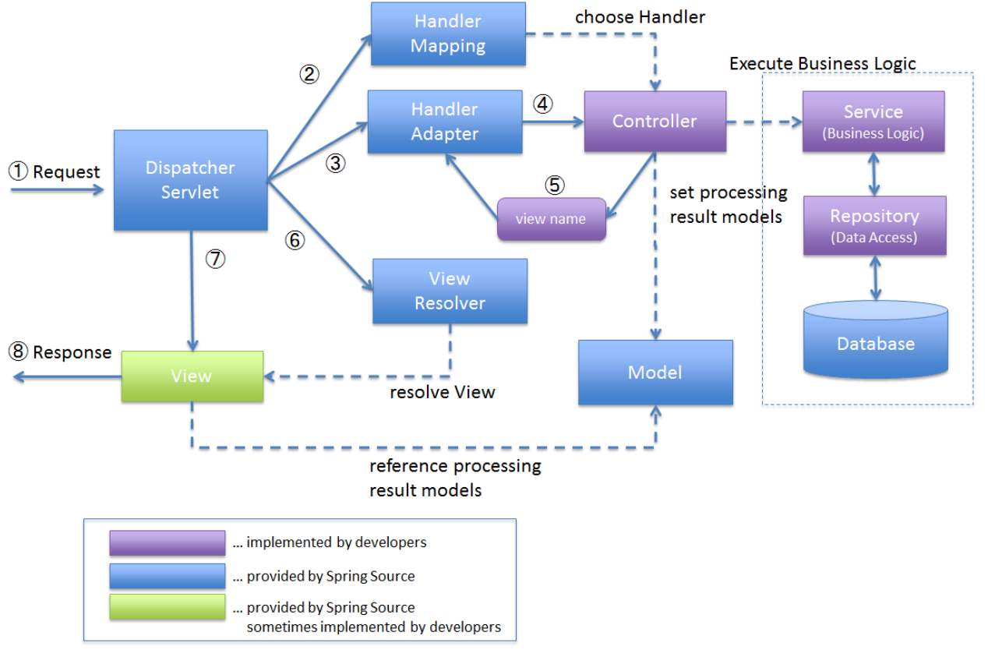
Architecture – Overview

Slide 23






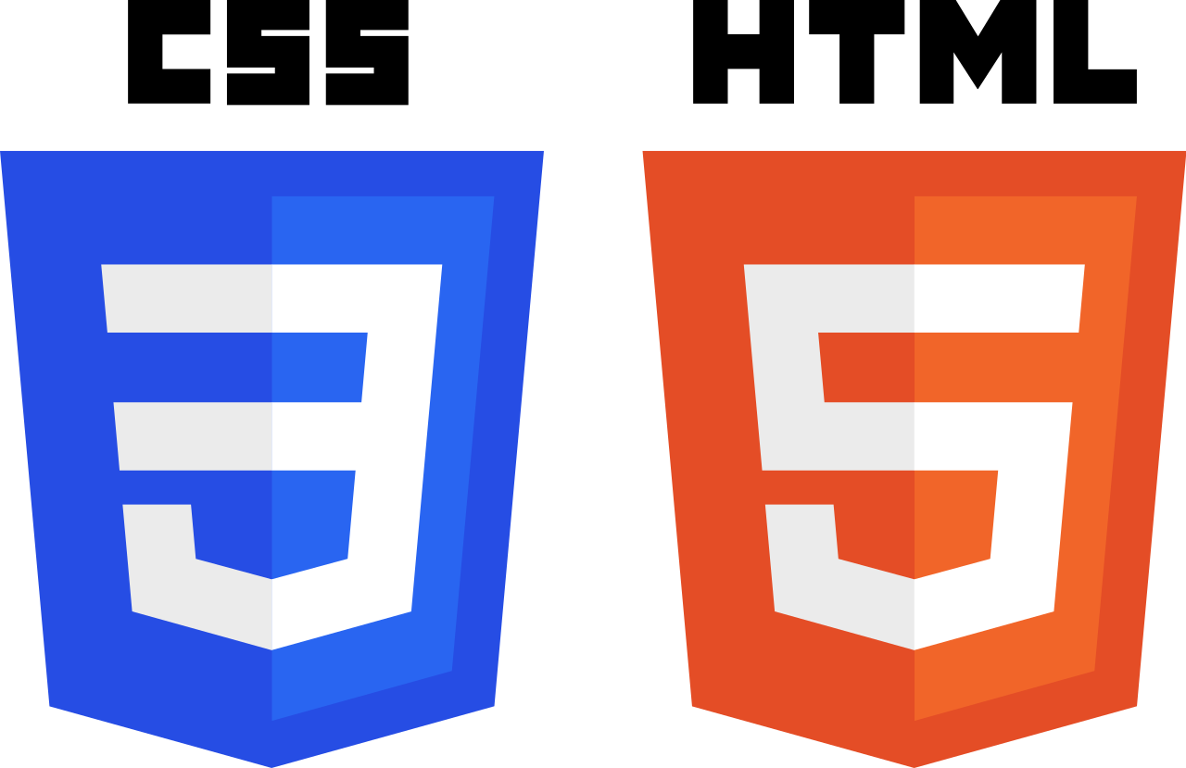










Technology
Backend
Frontend
Testing
Deployment

Slide 24
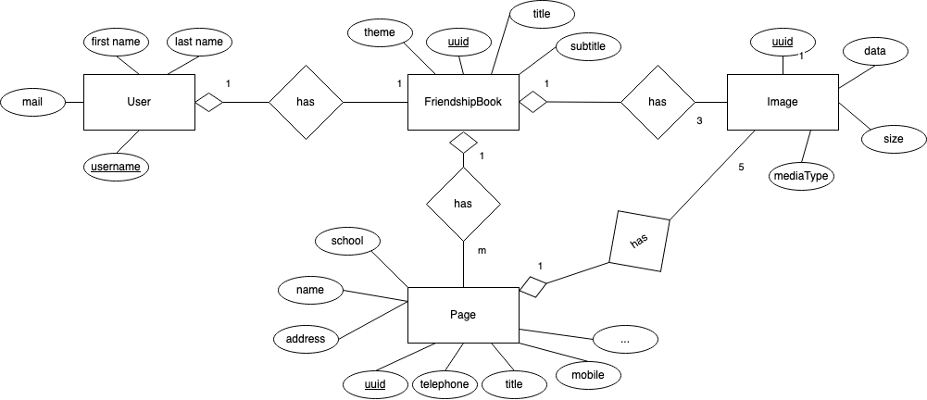
Database scheme – Data View

Slide 25
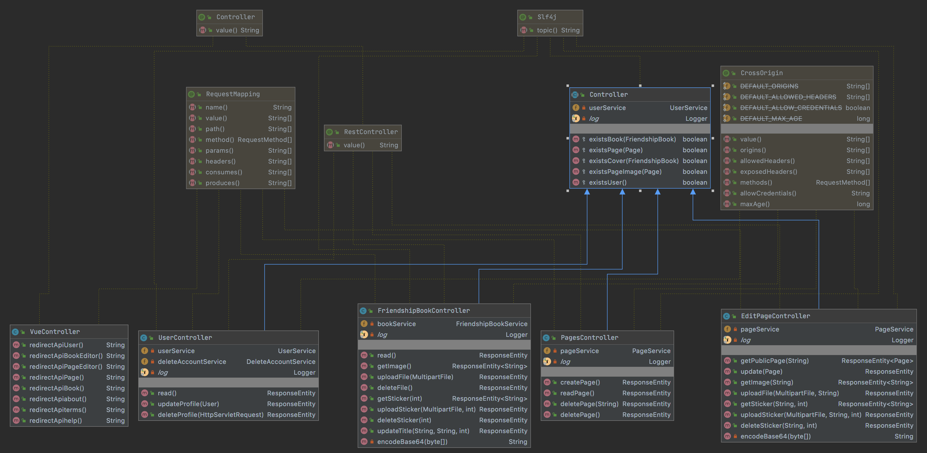
Class Diagram - Controller

Slide 26
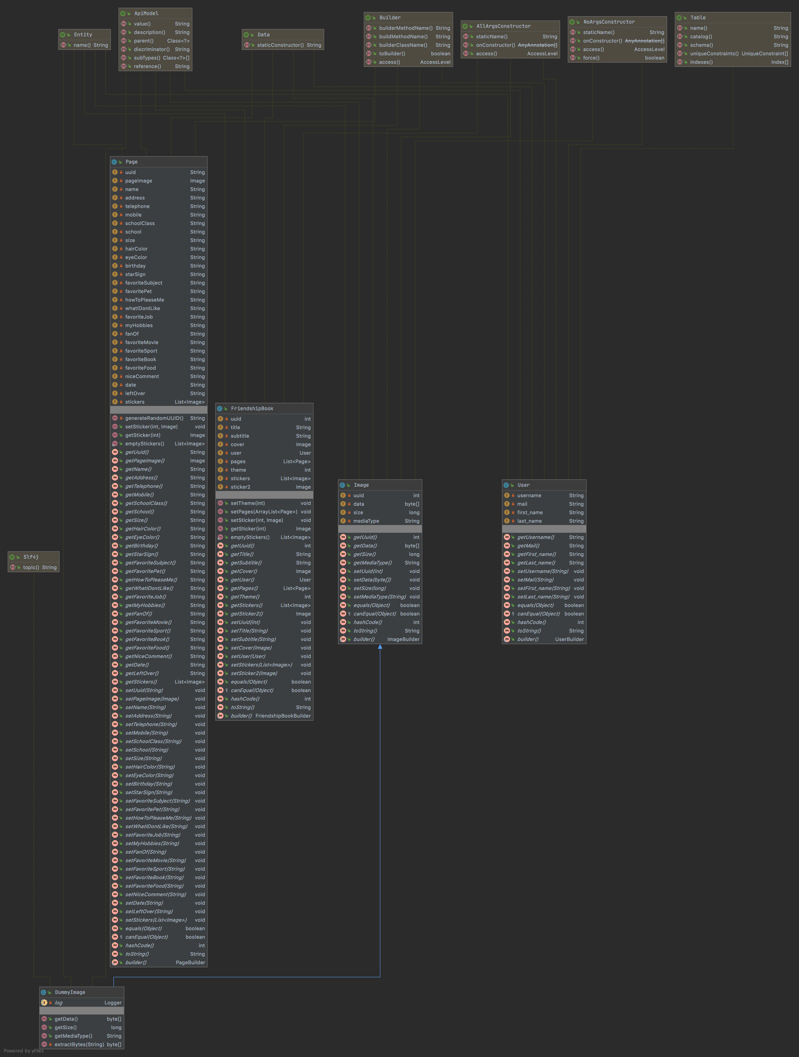
Class Diagram Model
►Whole view

Slide 27
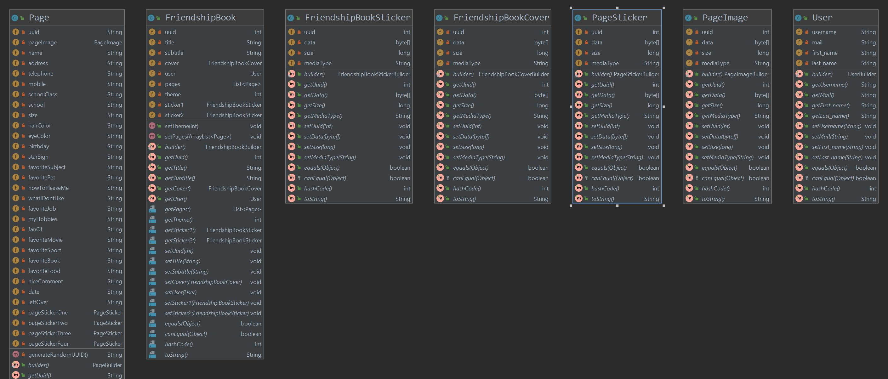
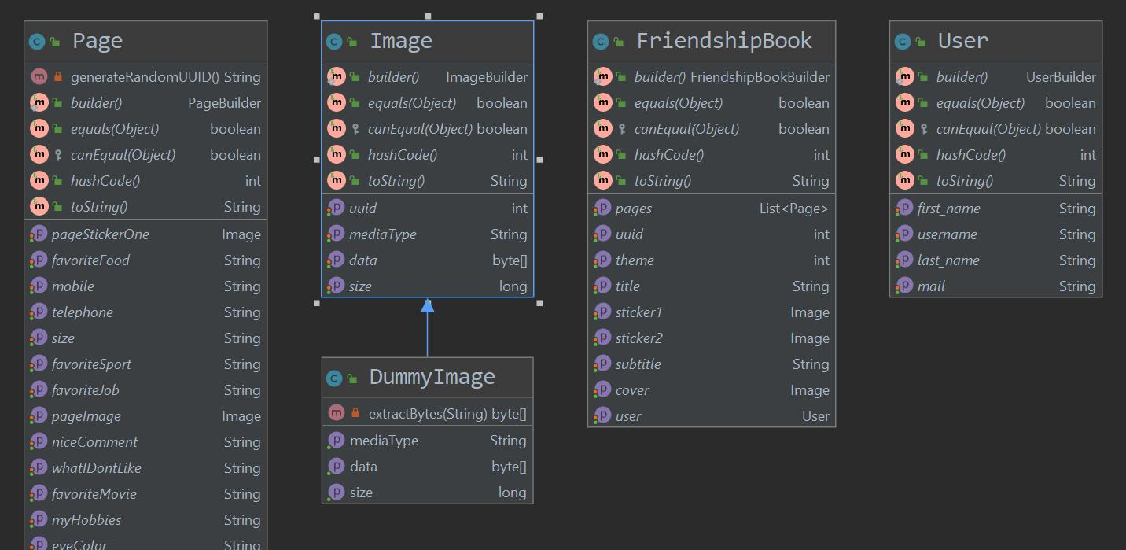
Design Patterns: Null Object
◀︎ before
After ▶︎

Slide 28
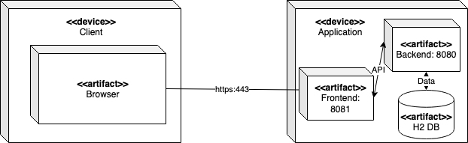
Architecture – Deployment View

Slide 29
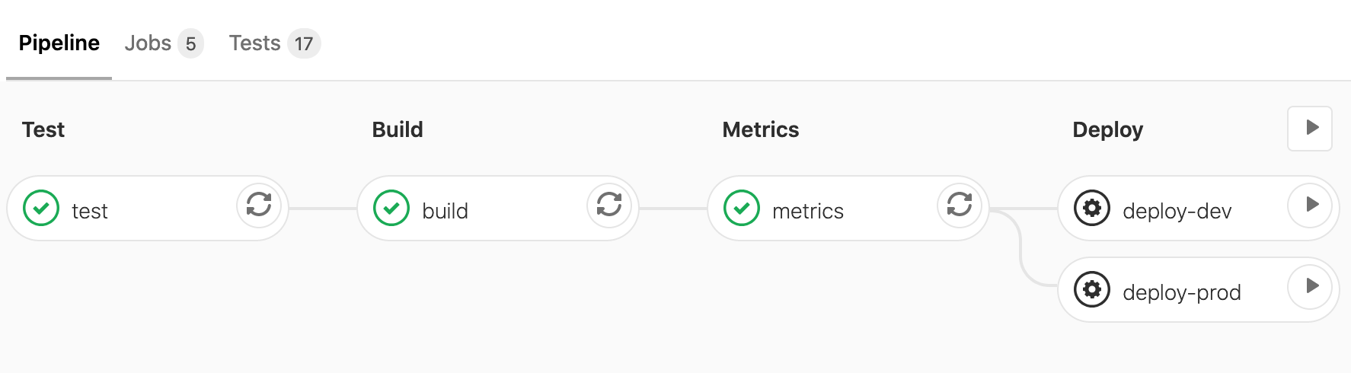
Continous Integration
Pipelines Test ► Build ► Metrics ► Deploy (automatic or manual)

Slide 30



Continous Integration
What | Code | Push to GitLab | Test Application | Metrics | Build Application | Deploy to Server
When | continously | Code is ready |  |  |  | + we decide
Where |  |  | ▼ ▼ | ▼ | ▼ | dev-system or stage-system

Slide 31
QUality

Slide 32
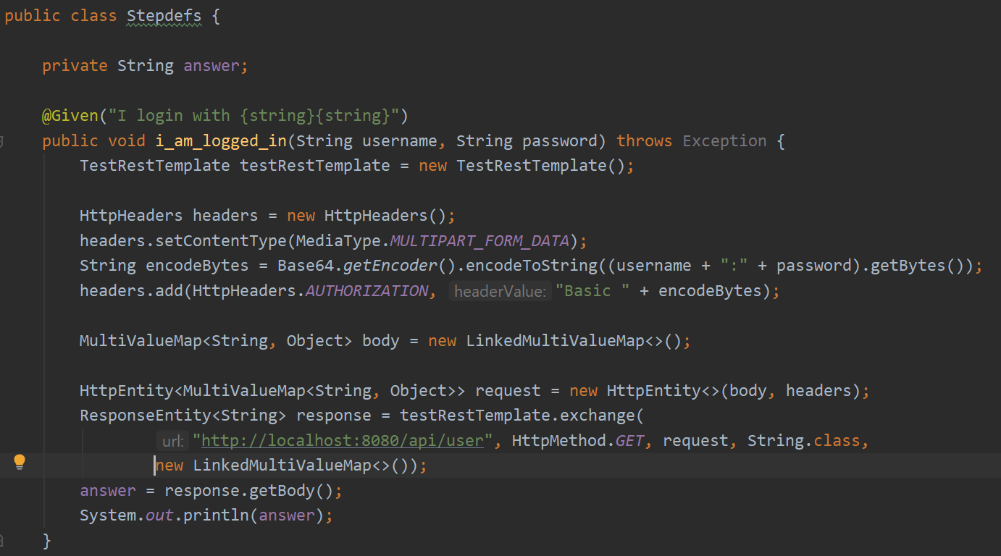

Testing
Automatic testing
Test results visible per commit
BDD tests with cucumber
JUnit tests
Database tests
(Field Tests)
Test Coverage

Slide 33
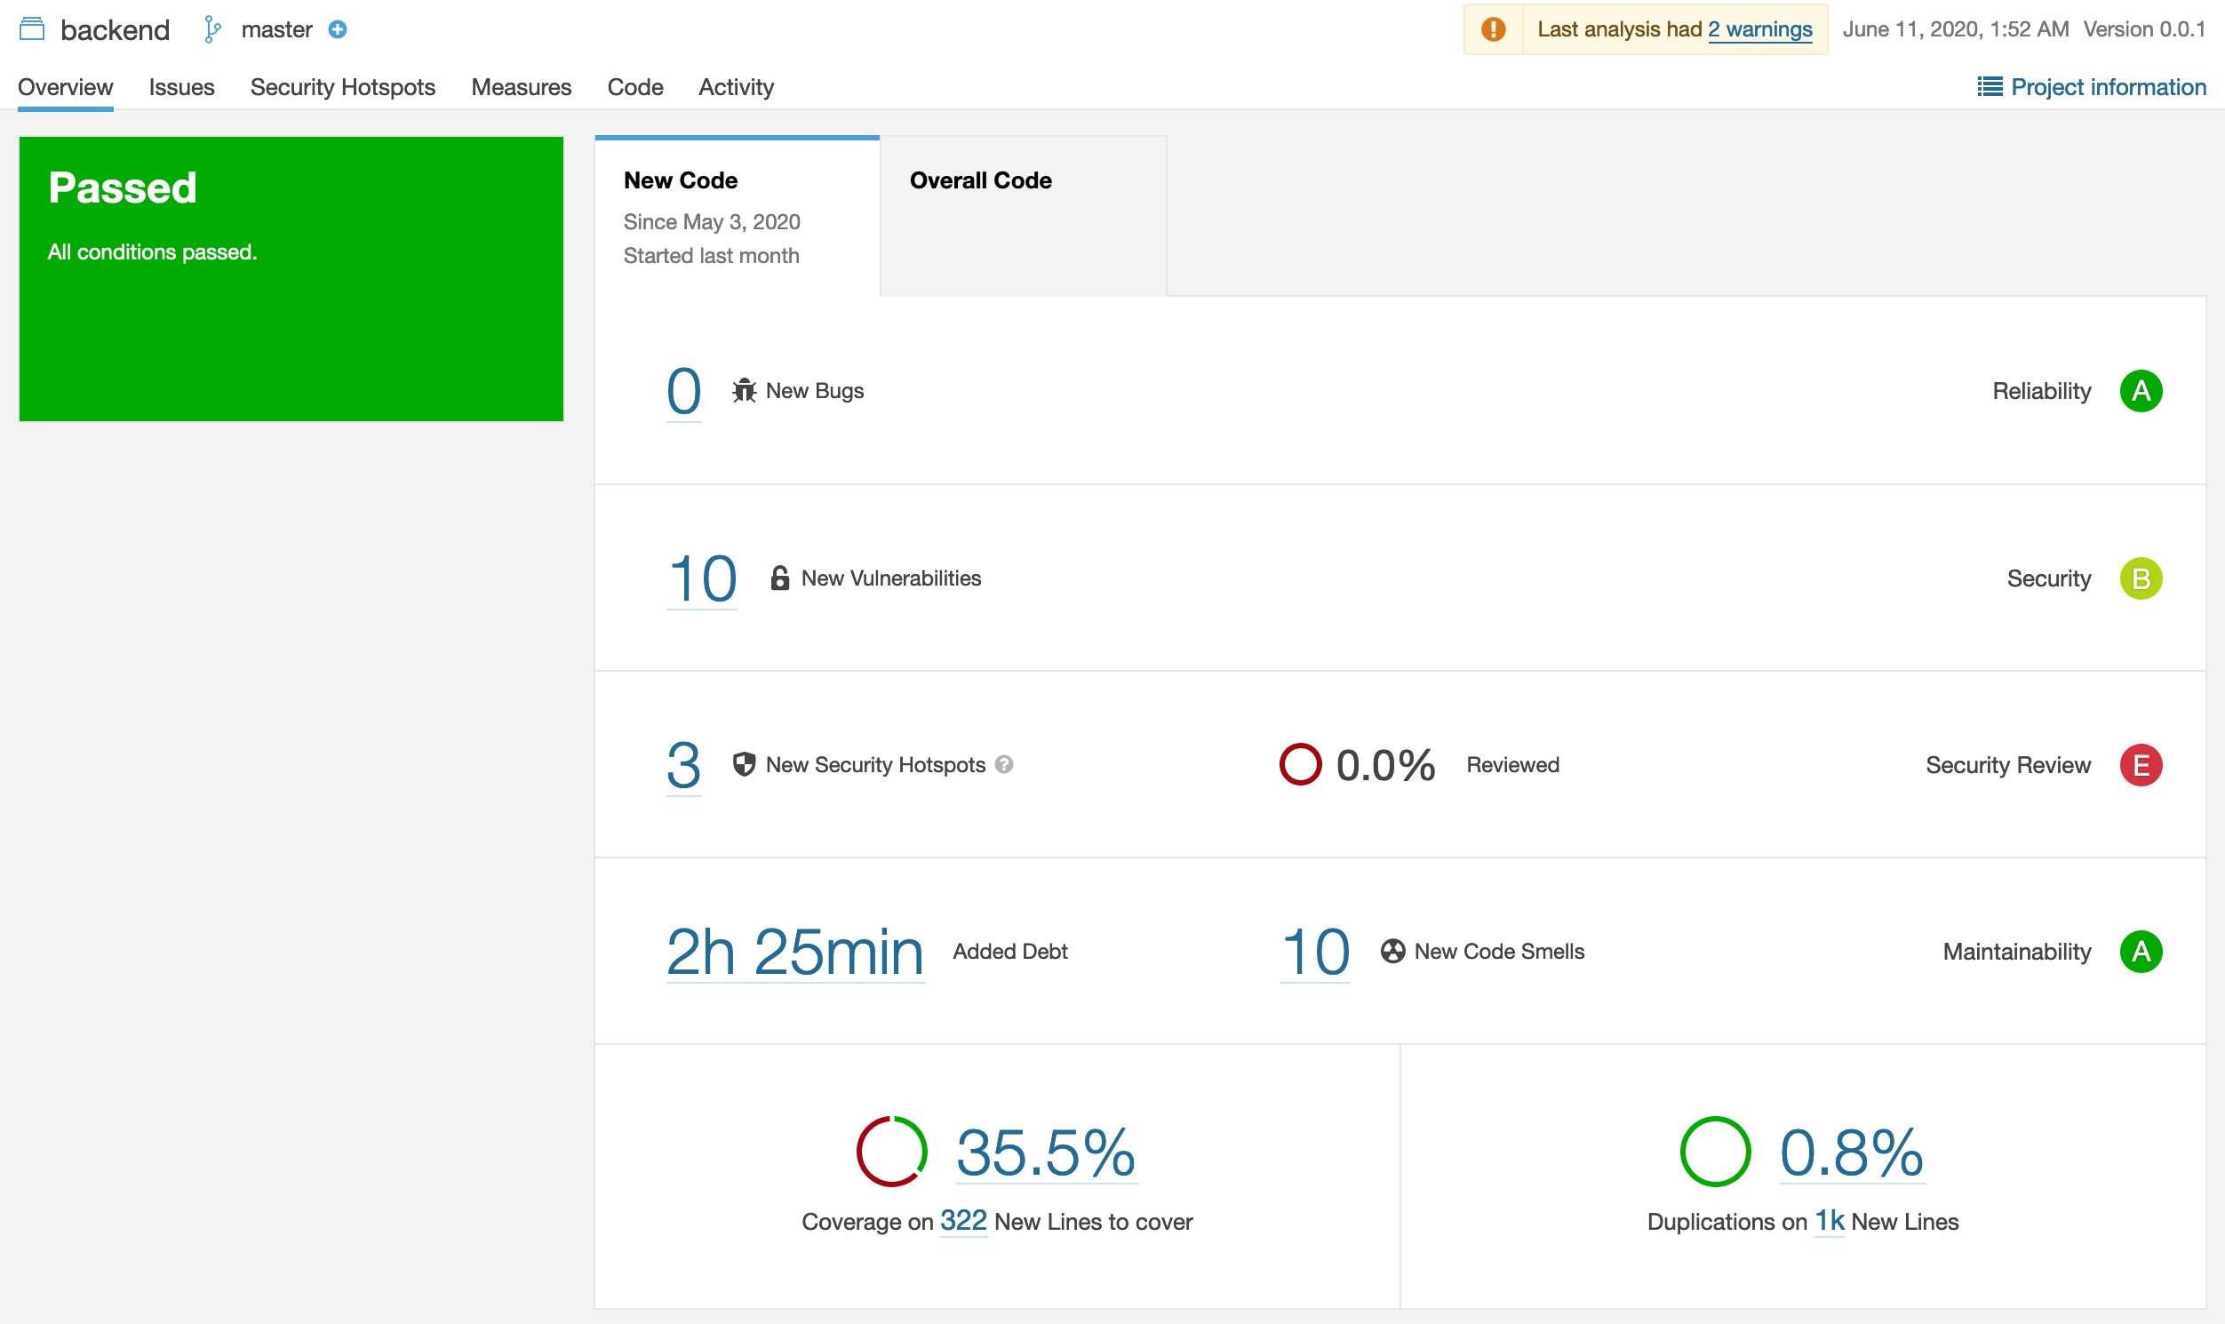
Metrics
▶︎Sonarqube

Slide 34
DEMO
BOOKLY - friendship book

